Slide 1
Azure Capstone project
yaminisilpa

Slide 2
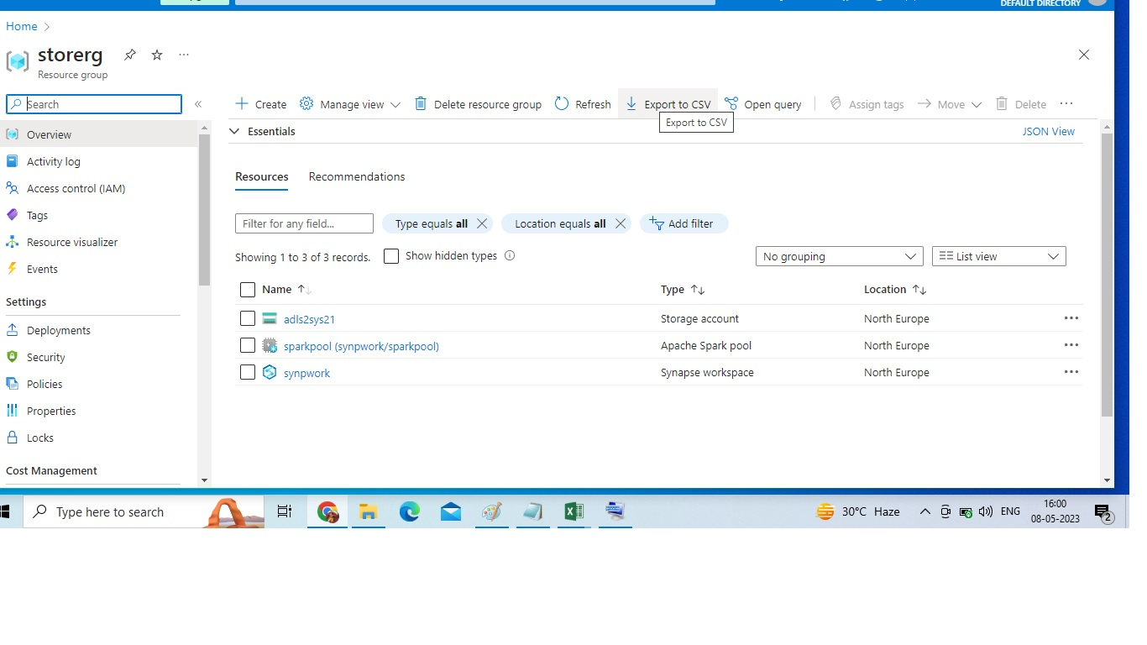
created Synapse workspace,ADLSgen2

Slide 3
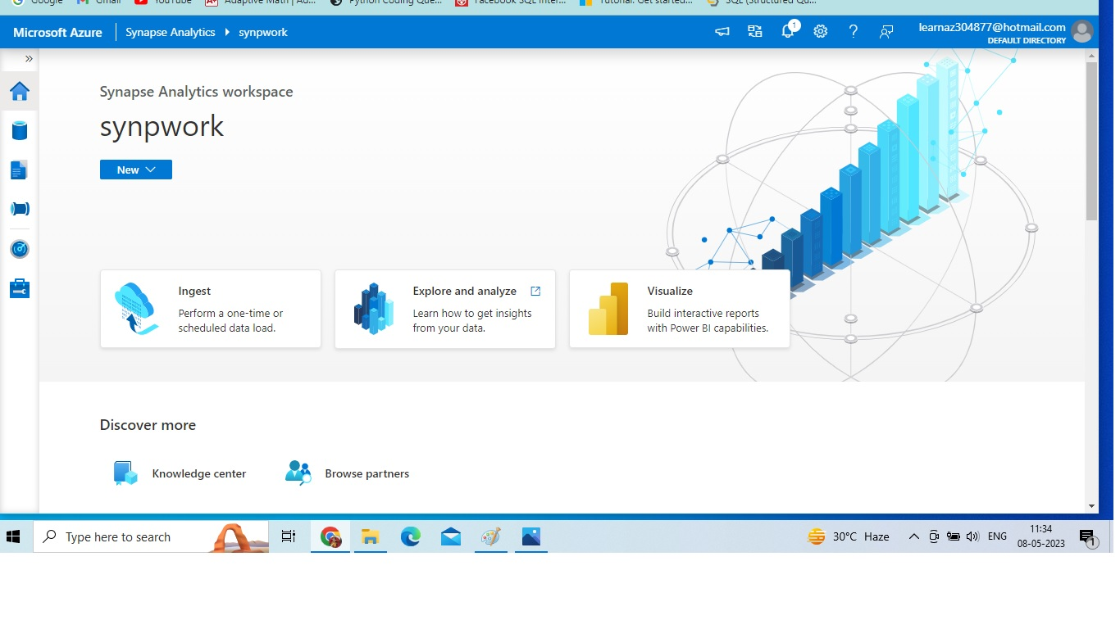
Synapse work space

Slide 4
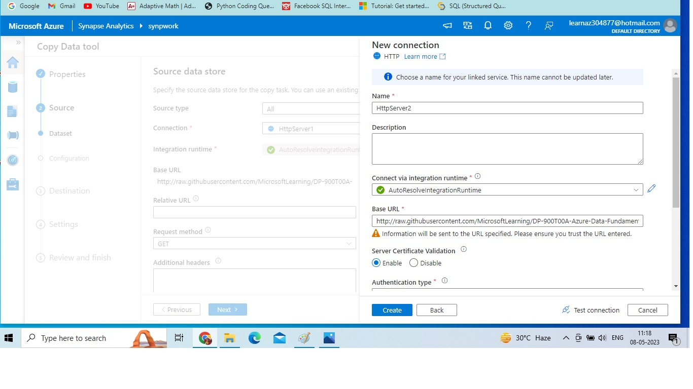
Source as HTTP

Slide 5
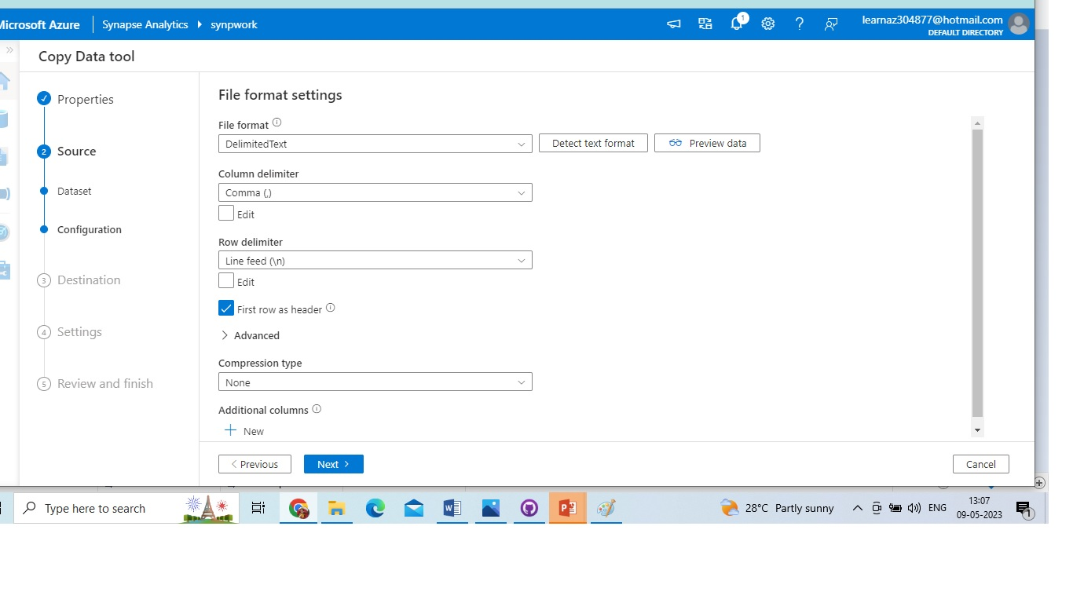
File format as Delimited text, column delimiter as Comma (,), Row Delimiter as Line feed (\n), First row as header as Selected and Compression type will be none.

Slide 6
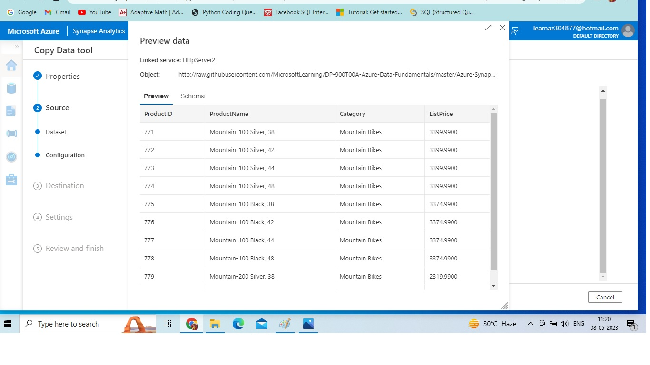
Source Data Preview

Slide 7
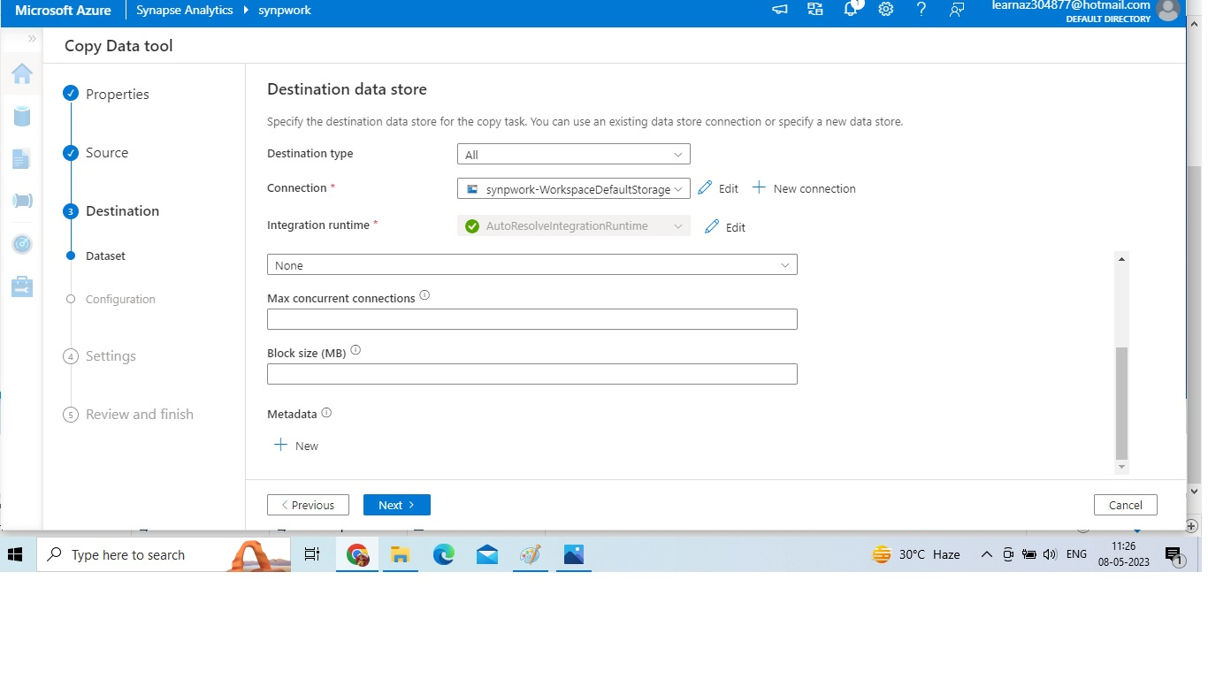
Destination as ADLS Gen2

Slide 8
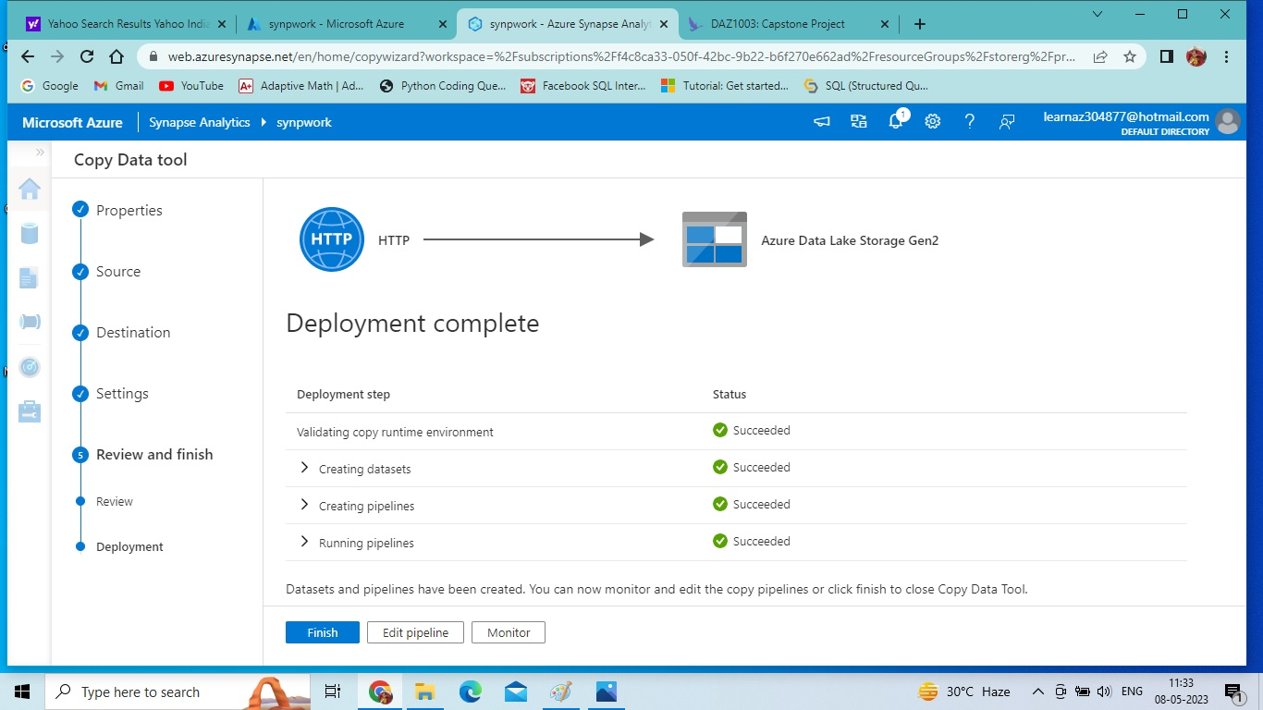
Connection Established

Slide 9
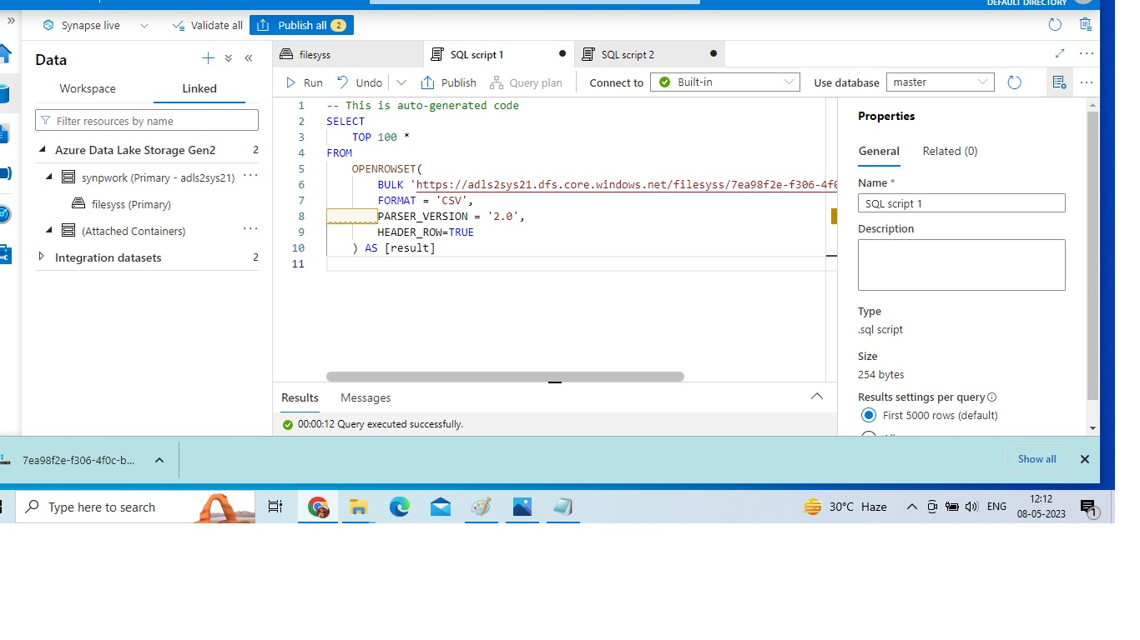
SQL query to show top100 rows and first row as header

Slide 10
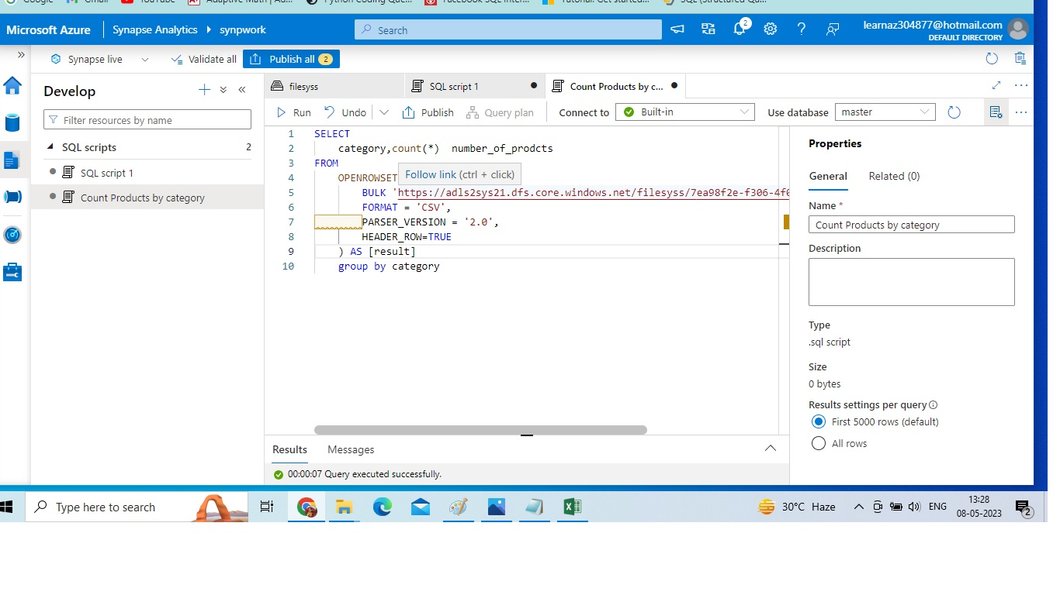
Updated the query by selecting the category and count as number_of_products and renaming the query as count products by category

Slide 11
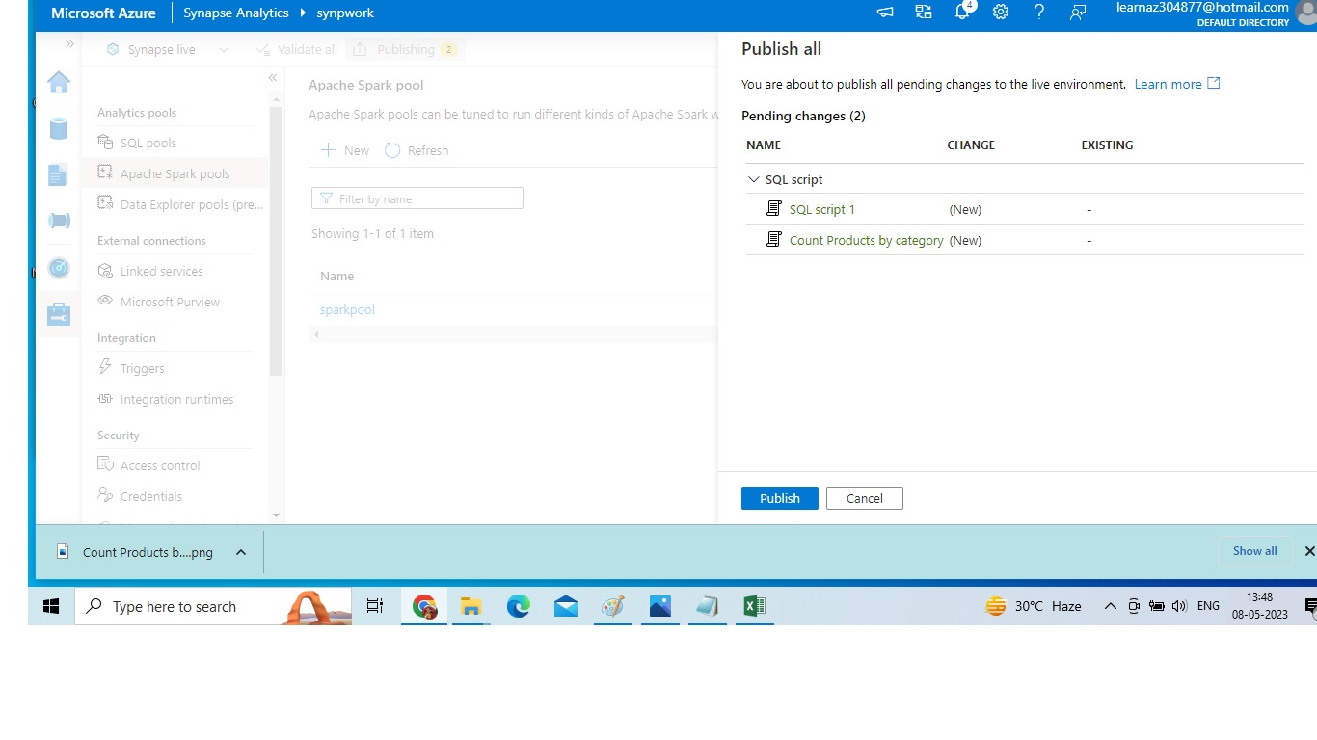
Published the code

Slide 12
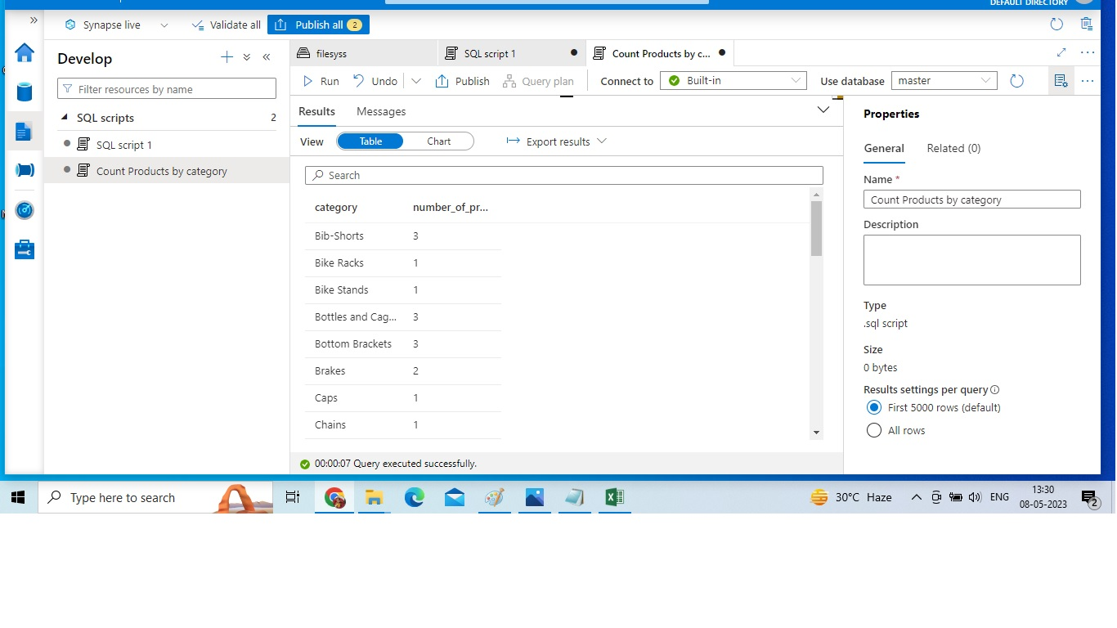
Result of the query

Slide 13
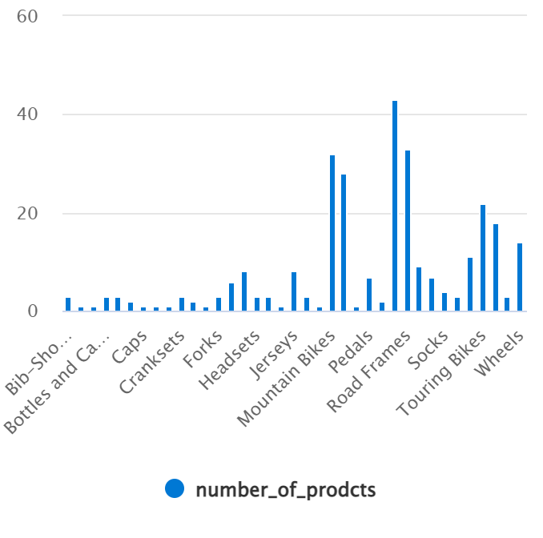
Chart View

Slide 14
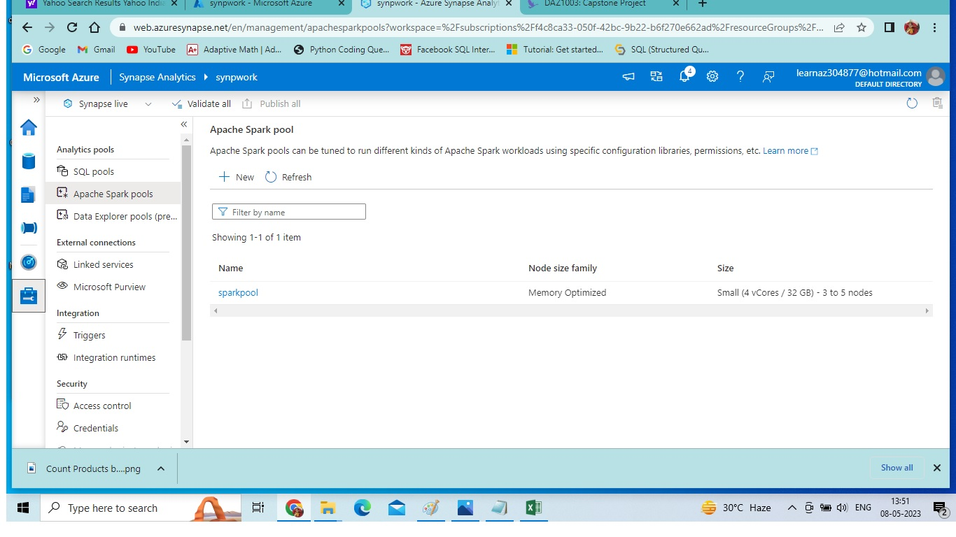
Apache spark pool

Slide 15
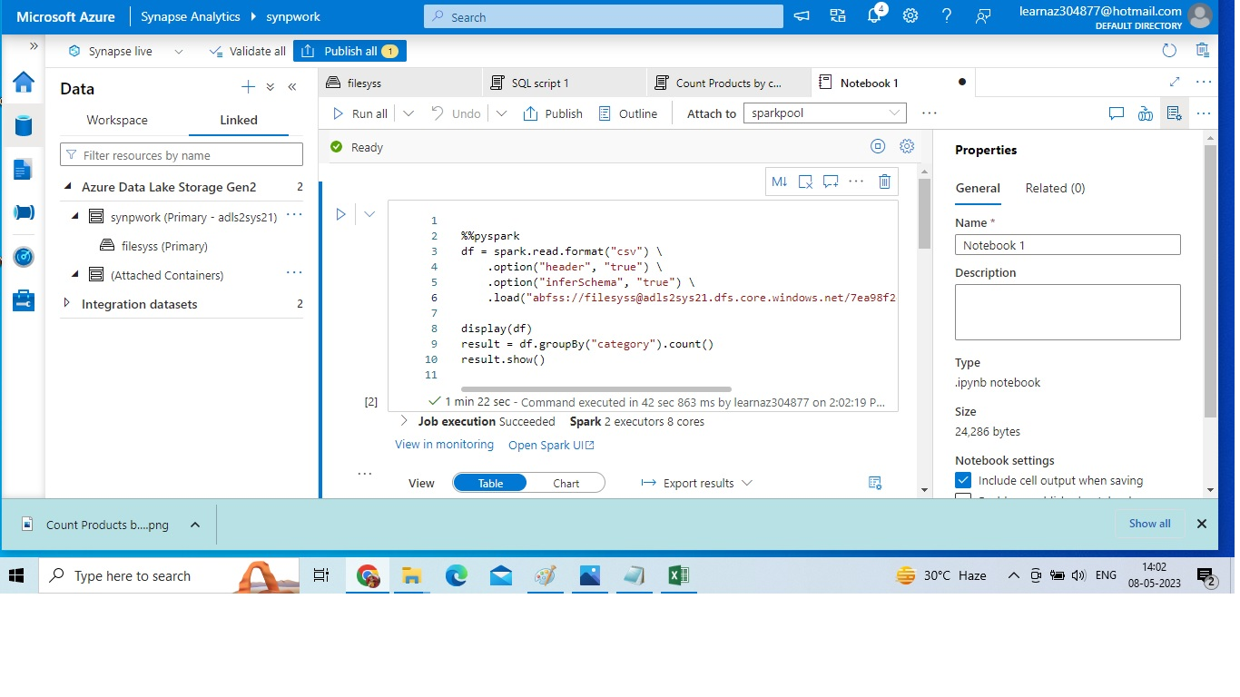
Queried the same set by using pyspark

Slide 16
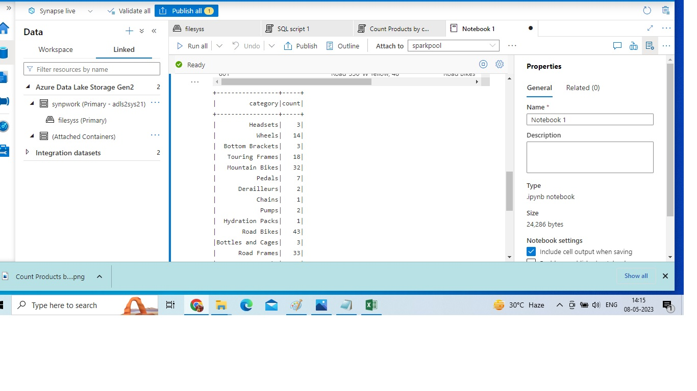
Result of pyspark query

Slide 17
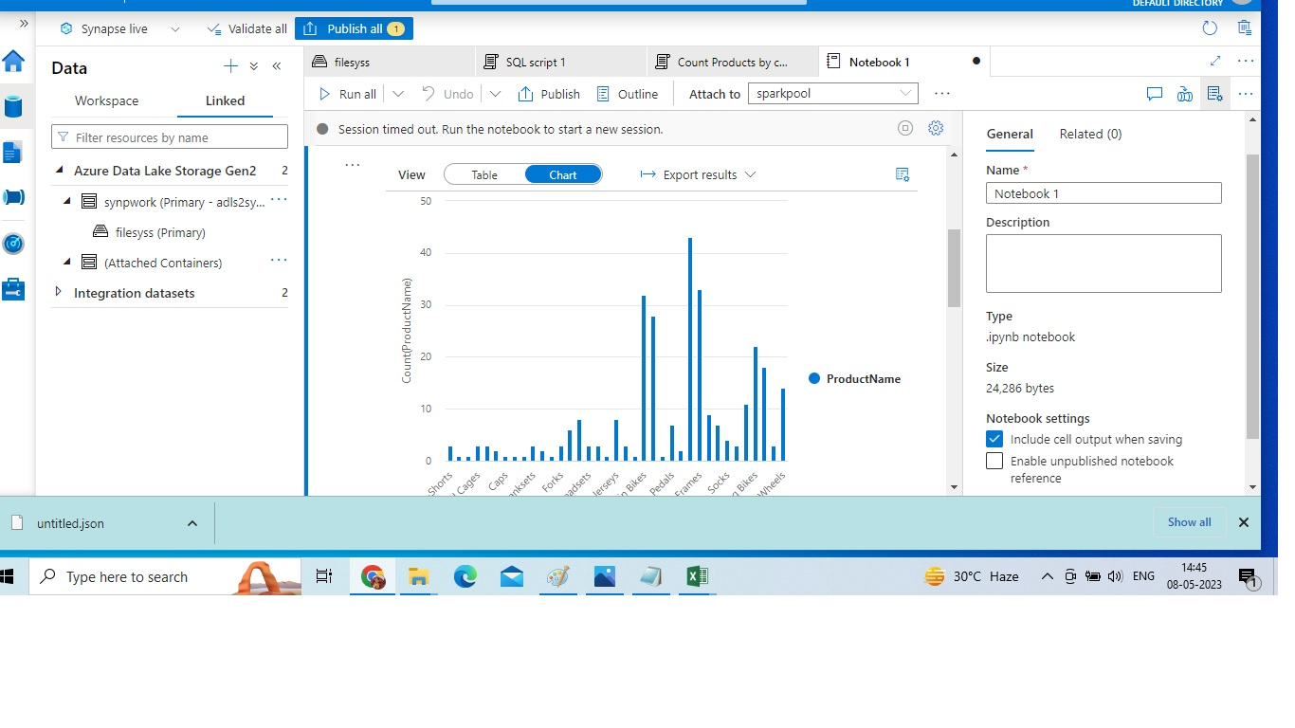
Chart view

Slide 18
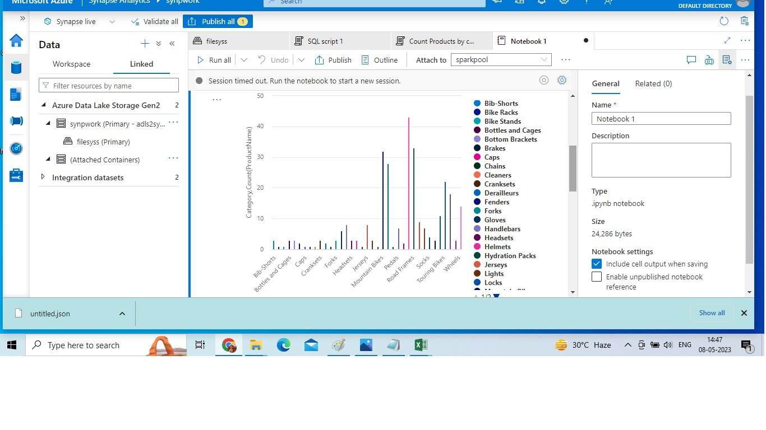

Slide 19
Thank you

